Slide 1

Comcast
Analysis & Insights

Slide 2
Table of Contents
1. Title Slide
2. Table of Contents
3.Introducing Problems
4-7. Introducing opportunities
8. Ending(Thank you)

Slide 3
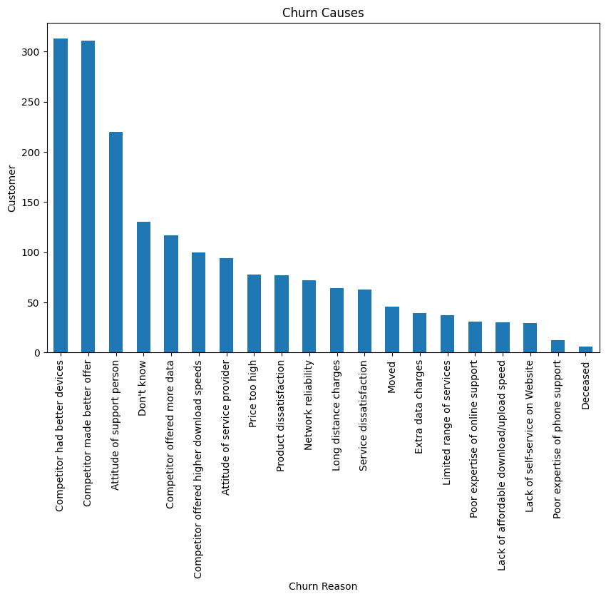
Problems
The Biggest cause of the churn is that the company is losing customers to competitors
people were getting better offers from competitors
people left to competitors that have better devices
people were leaving because of the attitude of your support staff

Slide 4
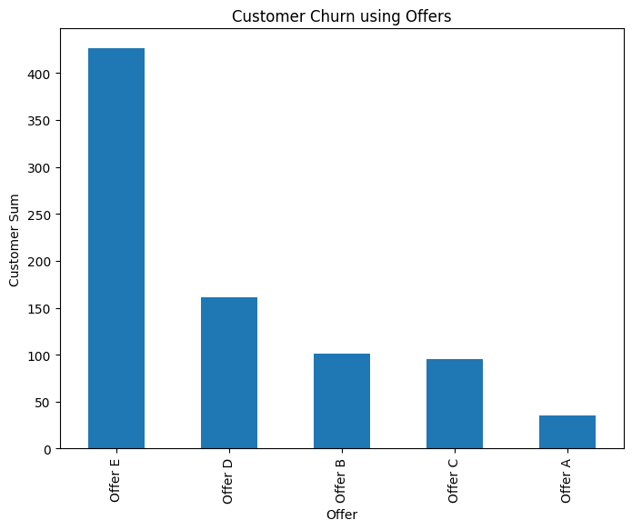
Offers
Customers that Churned the most were from Offer E which was inefficient at keeping Customers

Slide 5
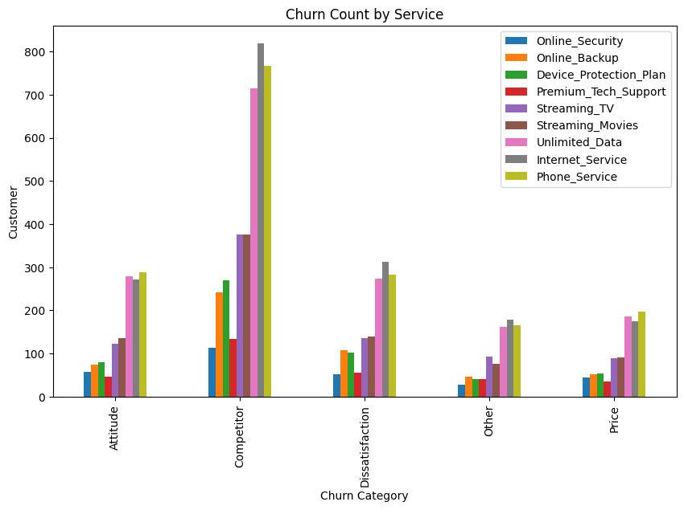
Services & Charges
The Services that caused the most churn were Phone service, Internet service, and Unlimited data

Slide 6
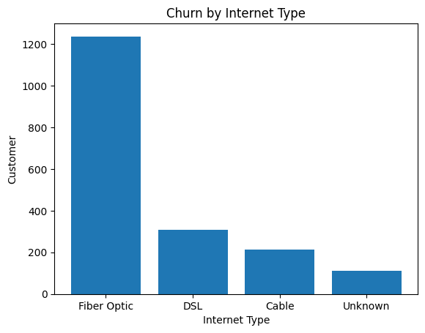
Internet Type
Fiber Optic was a big reason for churn regarding the Internet. DSL and Cable were more effective at keeping the Customer Base.

Slide 7
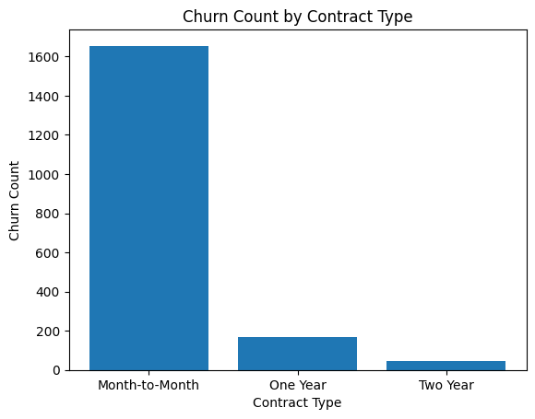
Contracts
Month to Month contacts were extremely bad at keeping customers and longer contracts were more effective.

Slide 8


Thank you, Comcast

